Slide 1

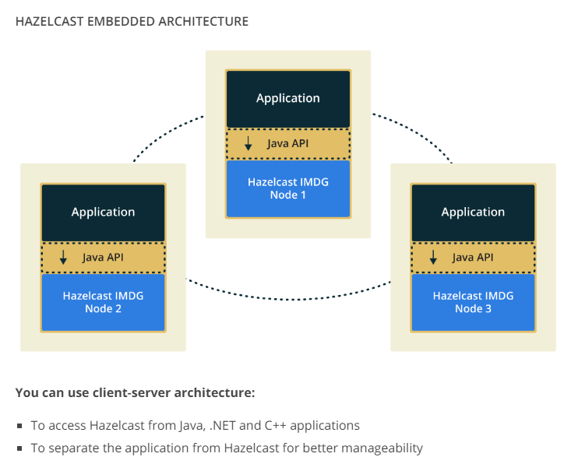
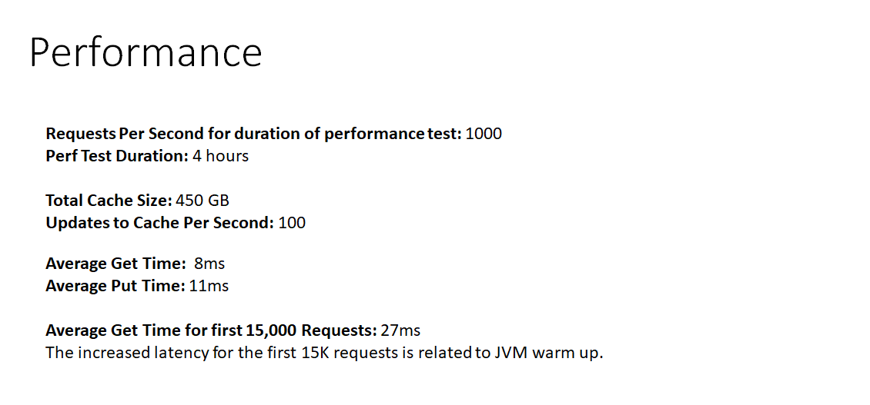

High Performance Caching of Data
UC-61
Abstract
Travelport is a travel e-commerce platform focused on providing distribution, technology, payment and other solutions for travel and tourism industry. This platform enables travel provider, agencies, corporations and developers to search, share, buy and sell travel.
Highlights
We used Hazelcast in-memory database.
We used Gemfire in-memory database.
We learned about single point of failure, redundancy, clusters and nodes.
We used java as the programming language for the API.
Experience
Working with the capstone group and Travelport allowed us to obtain insight into a world where customer satisfaction and retention are vital to the overall success of the company. Each student contributor has the basic knowledge of the software engineering fundamentals. We were able to collaborate with the VP of Solution Engineering(Leonard Greski) at Travelport and apply the concepts and techniques we have learned throughout our tenure at Kennesaw State University.
Future Career Plans
Everyone on our team will graduate from Kennesaw State University within the year of 2018 with a bachelor’s degree in software engineering. Most of us plan to work fulltime in the corporate environment for at least a year maybe two. It is likely that we will pursue careers at the respective companies that we have interned with during our tenure at Kennesaw State University. Most group members agree that once we have had our fill of the corporate world we will fully commit to being an entrepreneurs. There is discussion of us collectively launching a IT consulting brand in the near future.
Conclusions
In-memory database systems are used to be able to access data more quickly than retrieving it from the disk. The reduction in latency is critical to databases that have high demands on traffic. There are three main requirements to building a production-ready in-memory caching system: speed, failover, and load balancing. Not every caching system has the same approach to meeting these requirements, but they typically support a common feature set that is needed to meet the industry’s needs.
In conclusion, we implemented proof of concept applications with both Gemfire and Hazelcast in memory data-grids. Though both in-memory data-grids work for this project we chose Hazelcast, primarily because it required the least amount of resources to implement.
Using Hazelcast, Spring Boot, and Java we were able to complete our proof of concept application and run an API simulation that meets the scaling capabilities specified in our client’s requirements.
Introduction
Travelport is undertaking an effort to improve the way they cache inventory data using an in-memory database during their search process. The project
objectives are listed below:
Research technologies in the in-memory database space, and select a technology in which to build a proof of concept.
Develop behavioral and non-behavioral requirements for a cache application that can scale to 100 billion requests per month at associated peak usage
Avoid single point of failure
Acknowledgments
Robert Montgomery - Student Contributor
Macauley Odinaka - Student Contributor
Malcolm Frank - Student Contributor
Jarred Wilson - Student Contributor
Dickson Diku -Lead Student Contributor
Abebe Adamu - Student Contributor
Leonard Greski - Professional Client
Dr. Reza Parizi - Professor
Research Question(s)
Contact Information
RQ1. What are the main motivations to study in memory database technologies?
RQ2. Are any of in memory database technologies that have no single points of failure?
RQ3.What are the techniques and methods used to avoid point of failure?
RQ4. How do we efficiently scale to meet workload predictions of 100 billion requests per month (38,580 requests per second)?
rmontg16@students.kennesaw.edu (Robert Montgomery)
modinaka@students.kennesaw.edu (Macauley Odinaka)
jwill836@students.kennesaw.edu (Jarred Wilson)
aadamu@students.kennesaw.edu (Abebe Adamu)
ddiku@students.kennesaw.edu (Dickson Diku)
mfrank45@students.kennesaw.edu (Malcolm Frank)
Materials and Methods
References
Hazelcast IMDG for In-Memory Data Grid. (2018). Hazelcast.com. Retrieved 29 April 2018, from https://hazelcast.com/use-cases/imdg/
Redis 3.2.8 vs Hazelcast IMDG 3.8 Benchmark. (2018). Hazelcast.com. Retrieved 29 April 2018, from https://hazelcast.com/resources/benchmark-redis-vs-hazelcast/
I:O Threading - Hazelcast Reference Manual. (2018). Docs.hazelcast.org. Retrieved 29 April 2018, from http://docs.hazelcast.org/docs/latest-development/manual/html/Performance/Threading_Model/I:O_Threading.html
Redis 3.2.8 vs Hazelcast IMDG 3.8 Benchmark. (2018). Hazelcast.com. Retrieved 29 April 2018, from https://hazelcast.com/resources/benchmark-redis-vs-hazelcast/
Benchmarking Cassandra Scalability on AWS – Netflix TechBlog – Medium. (2011). Medium. Retrieved 29 April 2018, from https://medium.com/netflix-techblog/benchmarking-cassandra-scalability-on-aws-over-a-million-writes-per-second-39f45f066c9e
Cassandra Essentials Tutorials: Understanding Partitioning and Replication in Cassandra. (2018). DataStax: always-on data platform | NoSQL | Apache Cassandra. Retrieved 29 April 2018, from https://www.datastax.com/resources/tutorials/partitioning-and-replication
TimesTen In-Memory Database | Database | Oracle. (2018). Oracle.com. Retrieved 29 April 2018, from https://www.oracle.com/database/timesten-in-memory-database/index.html
Pivotal GemFire. (2018). Pivotal.io. Retrieved 29 April 2018, from https://pivotal.io/pivotal-gemfire
Pivotal GemFire formerly VMware vFabric GemFire - Distributed Data Management Platform. (2018). VMWare. Retrieved 29 April 2018, from https://www.vmware.com/products/pivotal-gemfire.html
Spring Boot Hazelcast Caching Example Configuration. (2017). Memorynotfound. Retrieved 29 April 2018, from https://memorynotfound.com/spring-boot-hazelcast-caching-example-configuration/
Results
Author(s): Macauley Odinaka, Robert Montgomery, Abebe Adamu, Dickson Diku, Malcolm Frank, Jarred Wilson
Advisors(s): Dr. Reza Parizi

